Slide 1
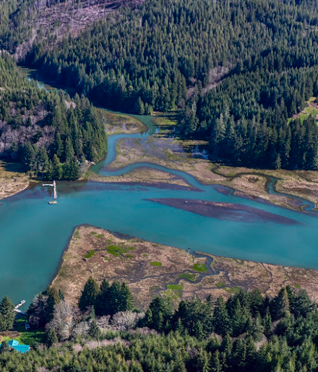

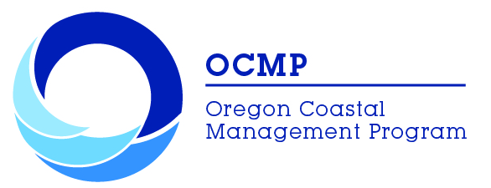
UPDATING THE ESTUARY MANAGEMENT PLAN FOR
YAQUINA BAY
June 27, 2023

Slide 2
The Coastal Goals
A subset of Oregon’s Land Use Planning Goals
Goal 16 – Estuary
Goal 17 – Coastal Shorelands
Goal 19 – Ocean Resources
Goal 18 – Beaches & Dunes

Slide 3
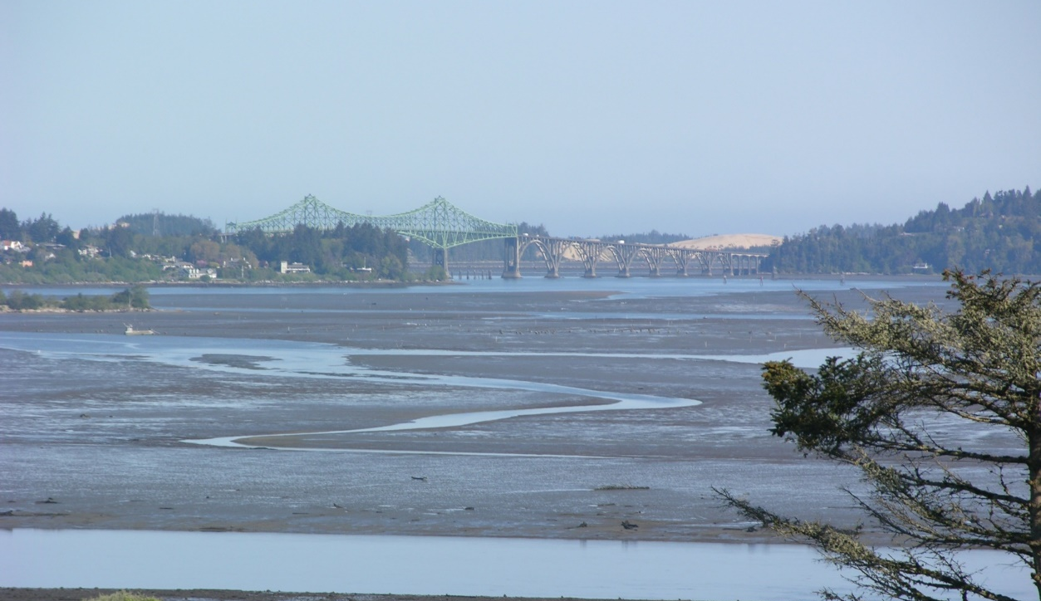
Goal 16: Estuarine Resources
Estuary Management Plans
Part of local Comprehensive Plans
Overall Management Classification
3 management unit types:
  Natural
  Conservation
  Development
Units specify permissible levels of development
Notes:
Goal 16 manages the uses and activities in estuaries, establishes detailed requirements for EMPs, coordination at local, state, federal levels
Review of individual development projects
Most requirements are carried out through local EMP’s and permits, but some are through state permitting processes (like DSL).
Oregon’s estuaries are first categorized into a management classification that specifies the level of development allowed in each estuary: natural, conservation, shall draft development, and deep draft development.
Yaquina Bay is a deep draft development estuary
Maintained to depths of 22ft or deeper with maintained jetties. Only 3 in Oregon.
Estuaries are then further categorized into management units within each estuary = natural, conservation, or development, based on biological and physical characteristics and features.
Proposed alterations are reviewed against these MU’s to ensure they are consistent with overall management objectives of that zone, to reduce adverse impacts, and to ensure compatibility with the adjacent shorelands.
Each management unit category specifies specific allowable uses and allows other uses if they can meet the G16 resource capability test. This test determines the impact of a proposed use and whether the resources and ecosystem can assimilate the impact and continue to function. All 3 management units may be applied in deep draft estuaries.

Slide 4
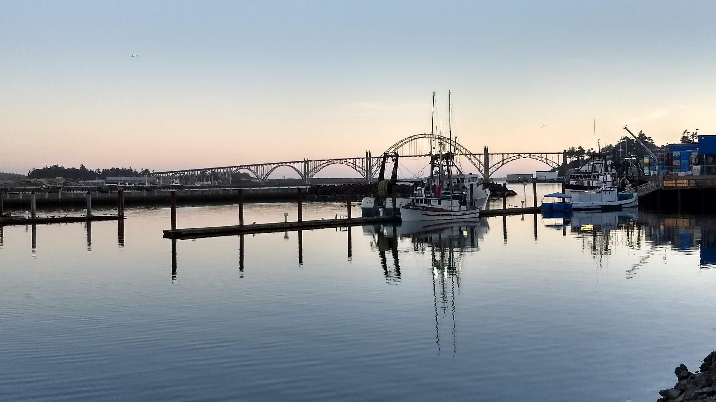
Yaquina Bay Estuary Management Plan
Notes:
Multi-jurisdictional plan
Developed in 1982
Lincoln Co holds for all estuaries in the county – city comp plans incorporate the relevant portions of the EMP
Amendments must be a coordinated effort with county and relevant cities, ports, state and federal agencies
Why update the plan? New information, understand and reflect values of the community, review process and maps, improve implementation

Slide 5
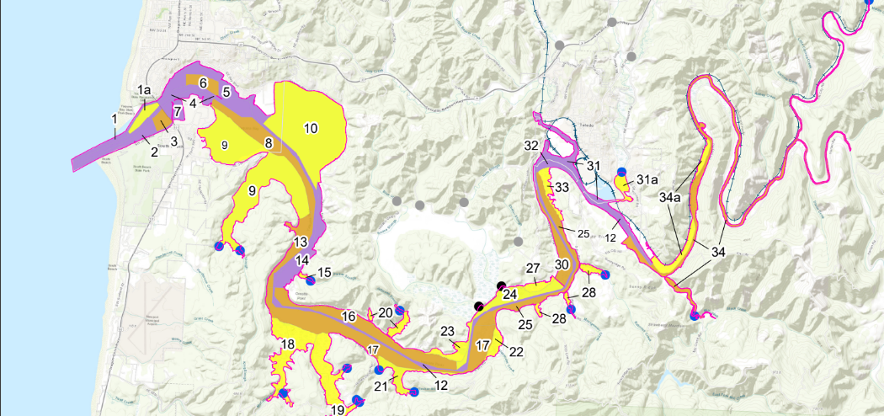
Regulatory Extent of Estuaries
Notes:
Regulatory extent of EMPs is all estuarine/tidally influenced waters extending up to head of tide. Landward to Mean Higher High Water or the line of non-aquatic vegetation
Regulatory extent is segmented into Management Units to regulate uses
Each Management Unit is classified as Natural, Conservation, or Development
Management Unit Classifications determines what uses or activities are Permissible, Conditional, or Not Allowed
Impact Assessments (informational) are required prior to any proposed alteration
Compensatory mitigation required for any dredge/fill of intertidal areas

Slide 6
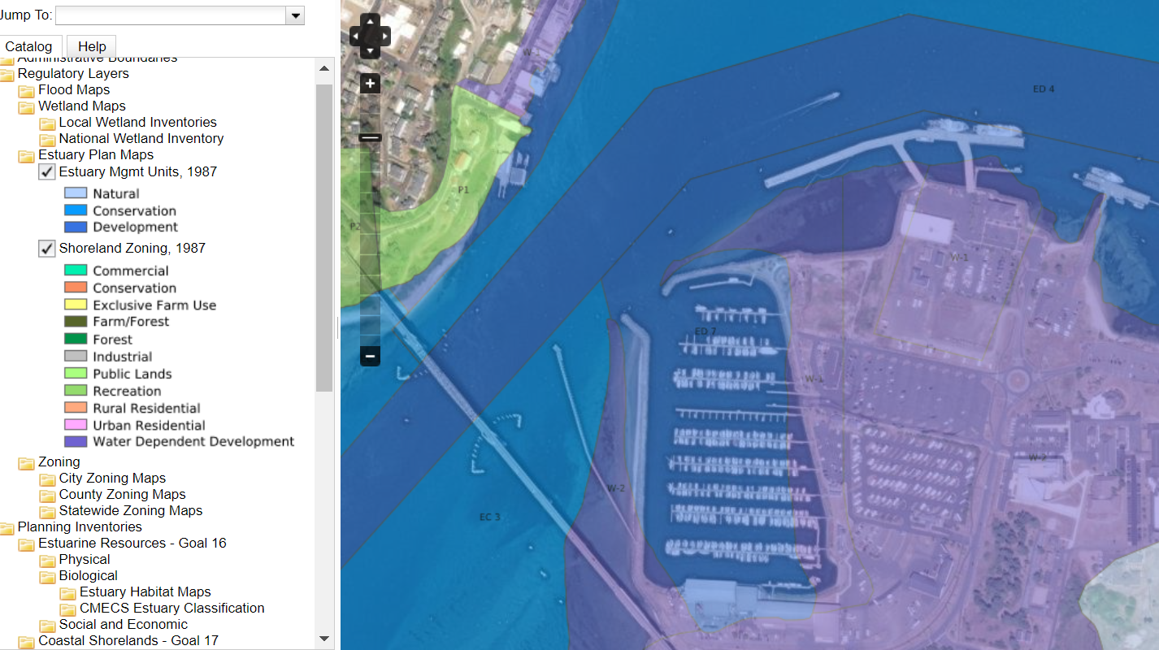
Notes:
Success of the plan over time – siting of the NOAA Research Fleet
Zoned for development and water-dependent shorelands to take place in those areas

Slide 7

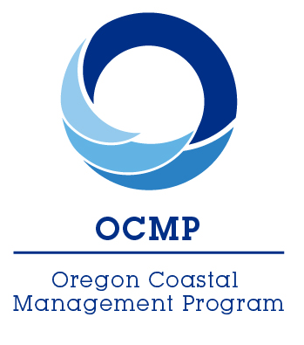
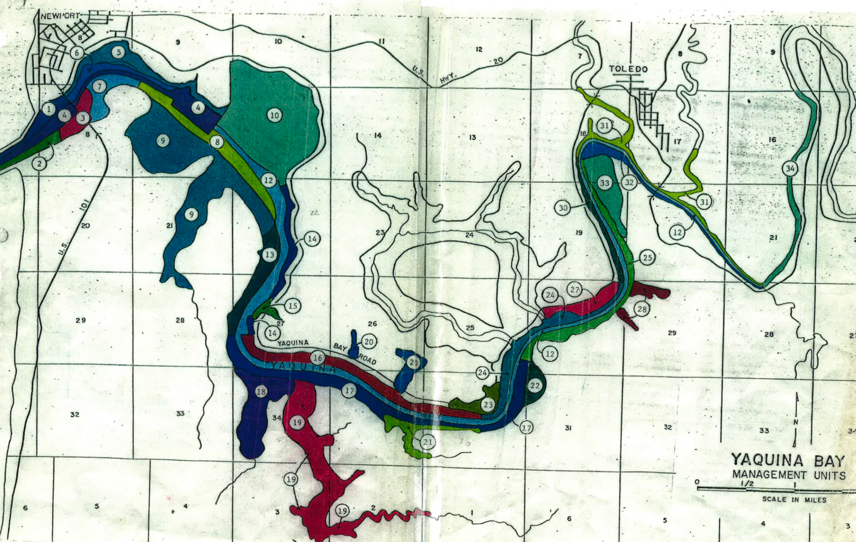


Modernization Effort
MATT SPANGLER
Lincoln County (Consultant)
Notes:
Image is the old plan maps
Funding – Project of Special Merit
Process support
Review and assessment of YBEMP
New data

Slide 8
Timeline
www.Yaquina-emp.org
Project Launch: May 2021
Steering Committee assembled
Consultant hired
Technical Update: July 2022-Mar 2023
Update Plan language
Technical subgroup assembled
Incorporate climate change
Draft Update: August 2023
Consultant contract ends
Formal review & adoption process
〜Winter 2024
Data Gathering /Needs Assessment: June 2021-June 2022
Advisory Group assembled
Inventories developed
Stakeholder Engagement: Apr - July 2023
Open House
Public release of draft EMP
Town Halls
Notes:
Modernization objectives:
Improve useability and implementation
Update relevant data and maps
Include impacts of climate change
Reflect on community values and needs
Must go through the Plan amendment process with each jurisdiction

Slide 9
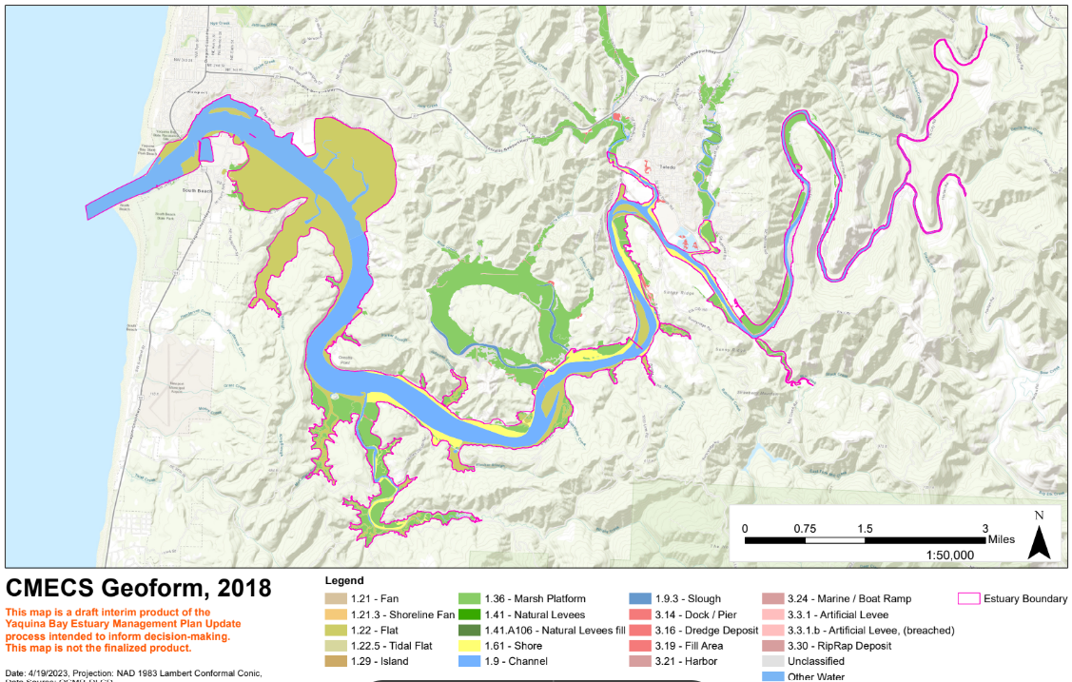
Updated Inventories & Maps
Head of Tide
Ownership
Fish Species
Estuary Tidal Wetlands
National Wetland Inventory
Dredged Material Sites
Aquatic
Biotic
Substrate
Soft Sediment Fauna
Historic Vegetation
Restoration Sites
Coastal Habitat
Flood Zones
Sea Level Rise
Landward Migration Zones
Tsunami
Notes:
Comprehensive review of all applicable data sets from various credible sources were compiled and reviewed.
These are inventory maps – help to inform management unit boundaries and development applications

Slide 10
Process
Key Roles of Steering Committee
Inform & review spatial data and maps
Review & approve changes needed
Review & approve draft Plan & Inventories for public release
Project Team
Steering Committee
Advisory Group
Technical Team
Key Roles of Advisory Group & Technical Sub-Group
Inform & review spatial data and maps
Inform & review climate change information
Provide guidance on community outreach
Review & provide feedback on Plan drafts & maps
Notes:
Steering Committee:
Onno Husing Lincoln County
Megan Hoff Lincoln County
Derrick Tokos City of Newport
Judy Richter City of Toledo
Stan Van De Wetering Confederated Tribes of Siletz Indians
Andrea Sumerau Confederated Tribes of Siletz Indians
Paula Miranda Port of Newport
Aaron Bretz Port of Newport
Debbie Scacco Port of Toledo
Lisa Phipps DLCD
Meg Reed DLCD
Brett Estes DLCD
There was an extensive outreach to a variety of people, including fishermen (commercial and industrial). If someone said yes, they were put on the AG. Where it becomes challenging is with the recreational fishermen – there are no organized groups (generally). But I imagine we do have local folks on the committee who do fish recreationally.

Slide 11
Proposed Revisions 2023
YBEMP Updates
Maps | Digital maps to replace hand-drawn maps
Language | Remove outdated references
Implementation Approach | Estuary Zoning Districts to replace Permitted Use Matrix
Update Certain Management Units | Splitting units, shifting boundaries, and reclassifying units to better reflect areas for protection and development
Climate Change | Consider and incorporate local climate vulnerabilities
Adaptive Management | Support future Plan updates when conditions change
Notes:
Outcomes for Yaquina Bay Community:
Improved & accessible information, data, and maps
Improved Plan implementation
Clarity around what uses and alterations are permissible, conditional, and not allowed across the estuary
Climate vulnerabilities described and included in analysis

Slide 12
Full Plan Table of Contents
I: Introduction
II: Overall Management Policies
III: Sub-Area Policies
IV: Classification System
V: Estuarine Use Standards
VI: Management Units
VII: Mitigation & Restoration
VIII: Log Storage
IX: Future Development Sites
X: Plan Implementation
XI: Plan Updates
Appendix A: Definitions
Appendix C: Goal Exceptions
Appendix D: Climate Vulnerabilities
Estuary Zoning District: Natural
Estuary Zoning District: Conservation
Estuary Zoning District: Development
Notes:
In the original YBEMP, there was no Appendix B – just A and C. I don’t know why.
Red font – not updated this time
Black font – revised in someway through this process
Blue font – new sections
Strikethrough – to be removed
Estuarine Use Standards were not updated this revision

Slide 13
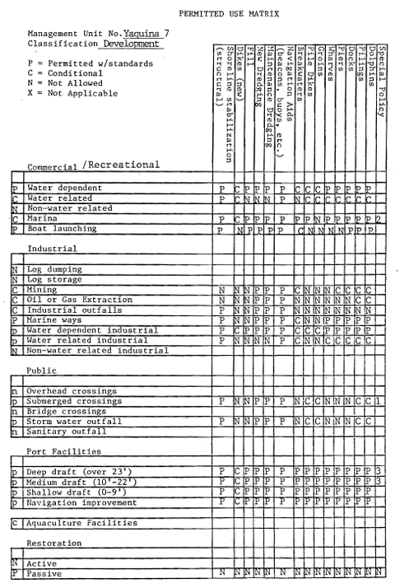

Slide 14
Impact Assessment
Shall include information on:
The type and extent of alterations expected;
The type of resource(s) affected;
The expected extent of impacts of the proposed alteration on water quality and other physical characteristics of the estuary, living resources, recreation and aesthetic use, navigation and other existing and potential uses of the estuary; and
The expected extent of impacts of the proposed alteration should reference relevant Climate Vulnerabilities as described in applicable sub-area(s) and management unit (applicants are encouraged to document the use of any applicable data and maps included in the inventory such as sea level rise and landward migration zones) when considering future:
  continued use of the proposed alteration given projected climate change impacts,
  water quality and other physical characteristics of the estuary,
  living resources,
  recreation and aesthetic use,
  navigation, and
  other existing and potential uses of the estuary;
The methods which could be employed to avoid or minimize adverse impacts.
Notes:
The Impact Assessment need not be lengthy or complex. The level of detail and analysis should be commensurate with the scale of expected impacts. For example, for proposed alterations with minimal estuarine disturbance, a correspondingly simple assessment is sufficient. For alterations with the potential for greater impact, the assessment should be more comprehensive.
In all cases, it should enable reviewers to gain a clear understanding of the impacts to be expected. It should be submitted in writing to the local jurisdiction.
Climate Vulnerabilities for Newport Sub-Area
Increased shoreline erosion due to changes in sediment transport or deposition patterns or increased intensity of storm surges
Increased frequency and extent of storm surge flooding due to sea level rise risking the integrity and hindering the use of critical infrastructure
Aquaculture and recreational shellfish losses due to ocean acidification and dissolution of oyster shells
Loss of suitable habitat conditions for eelgrass, sitka spruce swamps, or other critical species and habitats due to sea level rise, warming waters, or increased downstream sedimentation
Extended use of salt marshes, eelgrass beds, tidal channels and other cool water refugia habitats for juvenile salmonids and forage fish such as herring, anchovies, and smelt due to warmer upriver temperatures in the mid-summer to early fall
Increased risk of jetty or breakwater failures due to sea level rise and storm surge
Increased risk of loss of structural integrity to underground or submerged infrastructure due to higher water tables from sea level rise
Increased risk of sea level rise submerging port, marina, and other moorage space infrastructure
Increased risk of structural failure of boat ramp and recreation facilities due to sea level rise and storm surge
Increased risk to current dredging regime or location of navigation channels as erosion and accretion patterns change due to sea level rise and storm surge
Increased frequency and extent of storm surge flooding due to sea level rise of bay-adjacent industrial and waste treatment sites increasing risk of structural damage and pollution event
Increased risk of toxic leaks from erosion and destabilization of submerged sewer, natural gas and other pipes and utility lines due to changes in sediment transport and deposition patterns

Slide 15
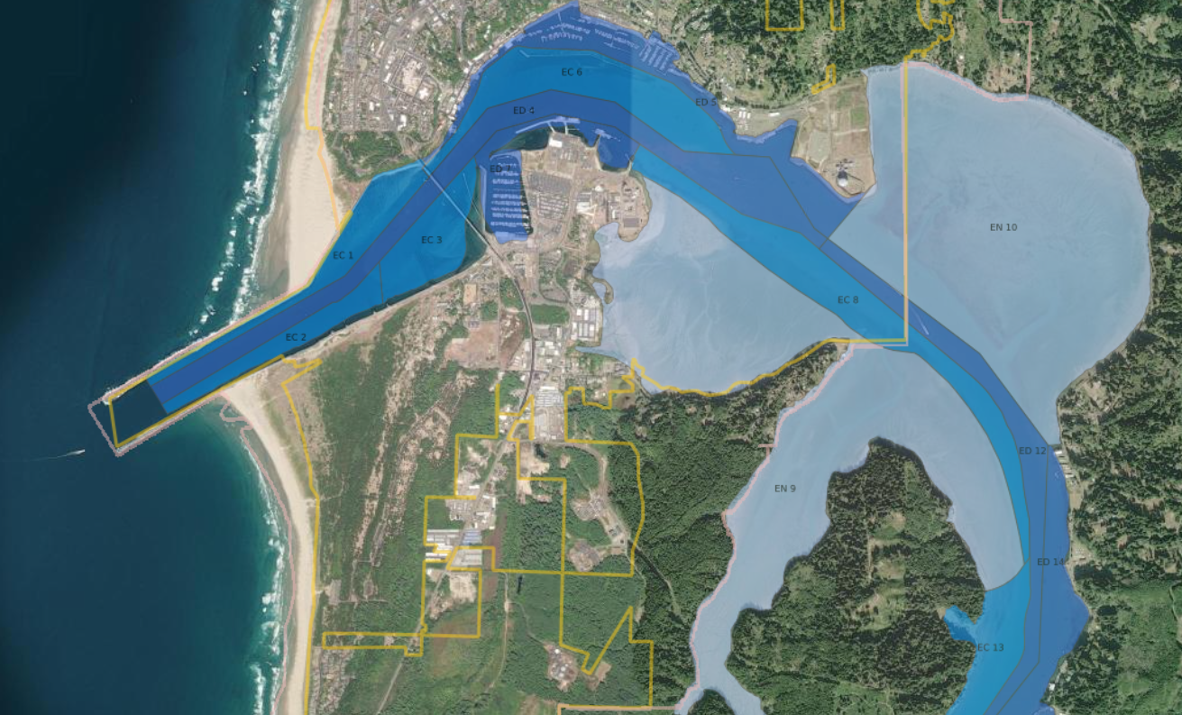
Notes:
Existing estuary management units

Slide 16
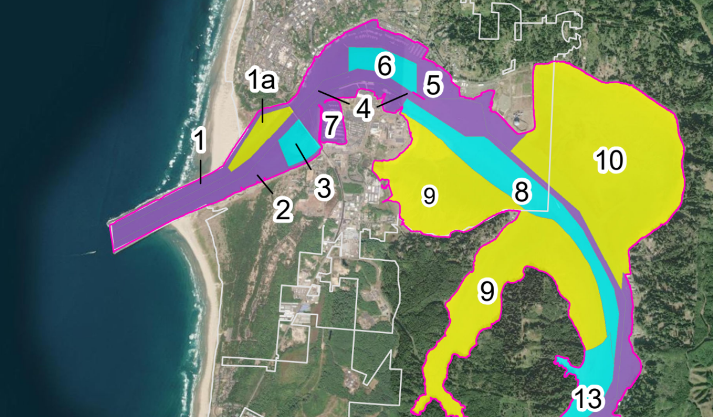
Notes:
Proposed changes to MU’s
Changes are circled – 1a is new (clam beds), 6 is smaller and is around a sensitive area, 5 is bigger and a development management unit
Those are only changes to MUs in Newport
Will need to update this for Toledo

Slide 17
Timeline
Project Launch: May 2021
Steering Committee assembled
Consultant hired
Technical Update: July 2022-Mar 2023
Update Plan language
Technical subgroup assembled
Incorporate climate change
Draft Update: August 2023
Consultant contract ends
Formal review & adoption process
〜Winter 2024
Data Gathering /Needs Assessment: June 2021-June 2022
Advisory Group assembled
Inventories developed
Stakeholder Engagement: Apr - July 2023
Open House
Public release of draft EMP
Town Halls
Notes:
Your role in this process

Slide 18
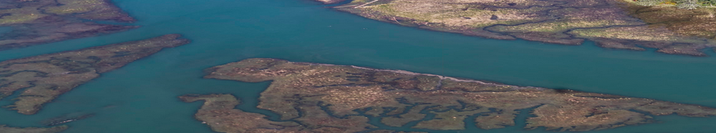
Thank you! www.yaquina-emp.org
Meg.REED@dlcd.oregon.gov
Lisa.PHIPPS@dlcd.oregon.gov
brown@willamettepartnership.org
mrhoward@uoregon.edu
ohusing@co.lincoln.or.us

Slide 19





External Factors
Notes:
FEMA BiOp – may impact development in the estuary
goal of no net loss (or no unmitigated impacts) to flood storage, water quality, and riparian vegetation from new development impacts in the SFHA.
HB 3382 – no long applicable to Yaquina Bay Estuary, just focused on Coos Bay estuary

Slide 20
Policy Levels
Overall Management Policies
Individual Management Units
Estuarine Use Standards
Impact Assessment
Resource Capabilities Test
Goal 16
Sub-Area Policies
Notes:
Each level of policy and the size of the area to which those provisions apply is smaller and more specific than the preceding level, ending with site specific guidelines at the management unit scale.
Impact Assessment is where the evaluation of climate vulnerabilities of the expected impacts are proposed
Blue circled area is where applicants mainly interact with the plan

Slide 21
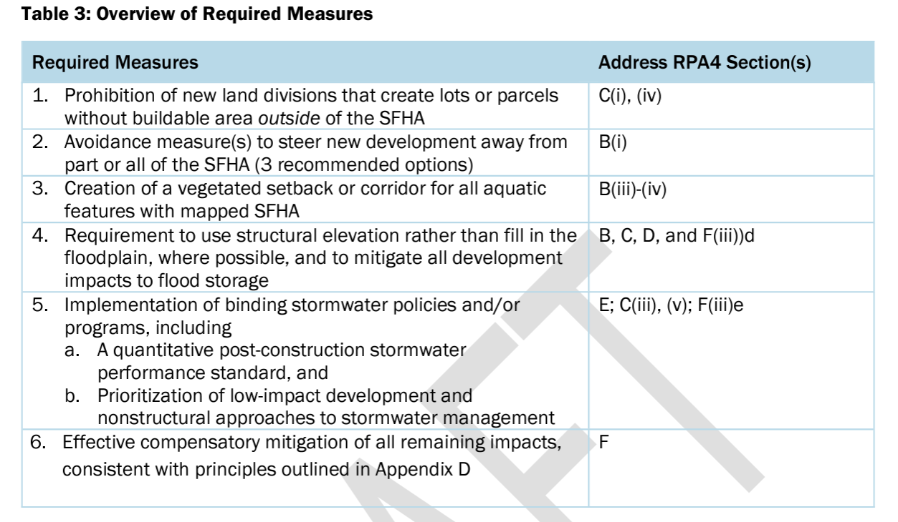
Notes:
Examples of what new requirements might look like
All development within the estuary is within the floodway. Adjacent development subject to Goal 17 might also be in the SFHA. That might be more affected by the BiOp implementation and that would be unrelated to the EMP requirements.

Slide 22
Advisory Group
Jerry Anderson Manulife Investment Management
Cheryl Brown US Environmental Protection Agency
Jevra Brown Oregon Department of State Lands
Bob Cowen Hatfield Marine Science Center
Tony D’Andrea Oregon Department of Fish & Wildlife
Kent Doughty Audubon Society of Lincoln City
Paul Engelmeyer Wetlands Conservancy/Audubon Society
Jon Gonzalez Pacific Seafood
Bri Goodwin Surfrider
Claire Hall Lincoln County Commissioner
Evan Hayduk MidCoast Watersheds Council
Megan Hoff Lincoln County
Cheryl Horton Midcoast Watershed Council
Onno Husing Lincoln County
Cameron La Follette Oregon Coast Alliance
Phillip Johnson Oregon Shores Conservation
Betty Kamikawa City of Toledo Councilor
Chris Knutsen Oregon Department of Fish & Wildlife
Heather Mann Midwater Trawlers
Jared Norton US Army Corps of Engineers
Jason Nuckols The Nature Conservancy
Ryan Parker City of Newport Councilor
Catherine de Rivera Portland State University
Liz Ruther Pew Charitable Trusts
Natalie Schaefer Yakona Preserve & Learning Center
Andrea Sumerau Confederated Tribes of Siletz Indians
Gil Sylvia Port of Newport
Stan Van De Wetering Confederated Tribes of Siletz Indians
Ted DeWitt US Environmental Protection Agency
George Waldbusser Oregon State University
Cora Warfield City of Toledo Councilor
Stephen Webster Websters
Derek Wilson Oregon Department of Fish & Wildlife
Liu Xin Local Oyster Farmer
Michele Zwartjes US Fish and Wildlife Service

Slide 23
Future Revisions
To be led by the County and/or Cities of Newport & Toledo:
Update Plan Part V - Estuarine Use Standards
Update Plan Part IX - Future Development Sites
To be led by DLCD
Develop guidance on how to further incorporate climate change into EMPs

Slide 24

EMP Guidance for Coastal Communities
Written for both communities with low capacity/resource-stretched AND those than have grant funds and external capacity
Based on Lessons Learned
Process-oriented
Concrete recommendations
Provide templates (e.g., work plans) when applicable and useful

Slide 25
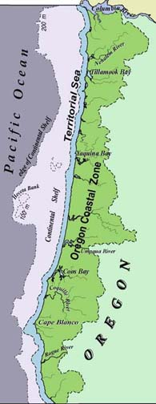
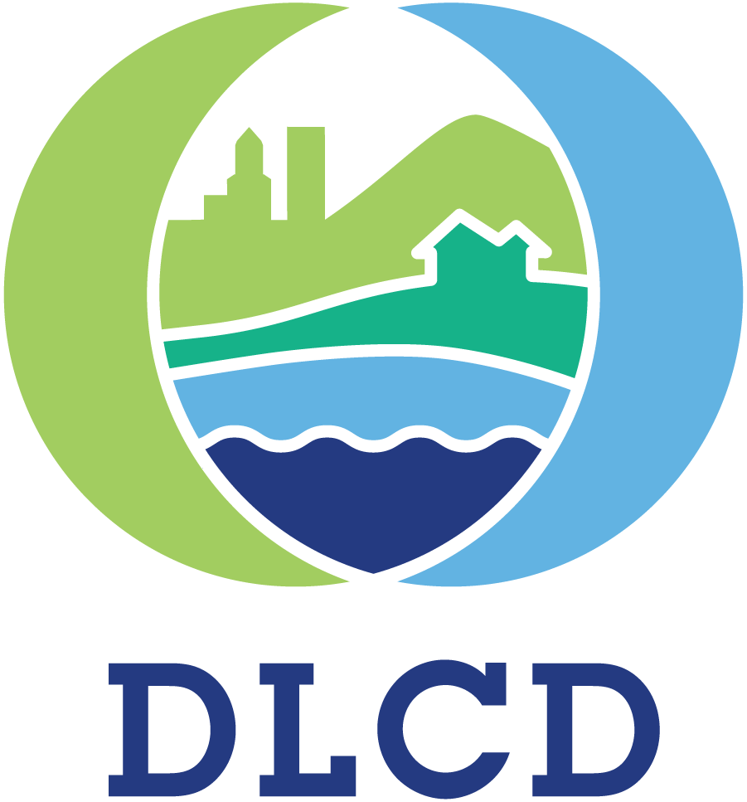
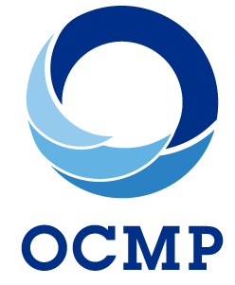
Oregon Coastal Management Program
COASTAL ZONE
362 Mile Coastline
22 Major Estuaries
7,800 Sq. Miles
COUNTY PARTNERS
Clatsop
Tillamook
Lincoln
Lane
Douglas
Coos
Curry
CITY PARTNERS
Coastal Watershed
Astoria
Warrenton
Seaside
Gearhart
Cannon Beach
Manzanita
Nehalem
Wheeler
Rockaway
Garibaldi
Bay City
Tillamook
Lincoln City
Depoe Bay
Siletz
Newport
Toledo
Waldport
Yachats
Florence
Dunes City
Reedsport
Lakeside
North Bend
Coos Bay
Coquille
Myrtle Point
Powers
Bandon
Port Orford
Gold Beach
Brookings
Territorial Sea
0-3 Miles
1,100 Sq. Miles
Notes:
It’s important to note that the OCMP’s network has a wide area that it covers – known as the “coastal zone”
And Oregon’s coastal zone is larger than many other states
Spanning from the crest of the coast range, all the way out to 3 nautical miles out to sea (also known as the state’s waters or the territorial sea)

